Slide 2
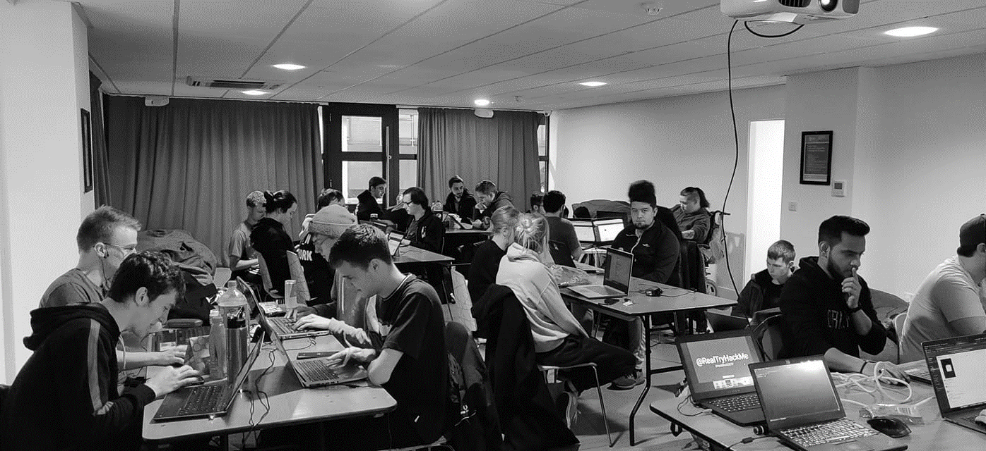



/dmuhackers
@dmuhackers
Phishing

Slide 3
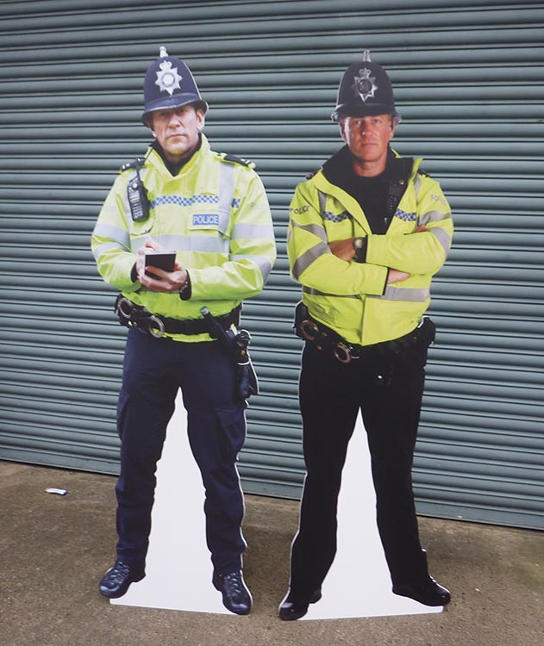

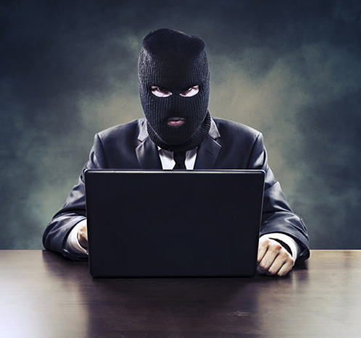
Disclaimer
Don’t do illegal shit

Slide 4
Overview
Wtf is Phishing?
Phishing and the real world
Phishing tools
Activity?

Slide 5
Wtf is Phishing?

Slide 6
“Phishing is the fraudulent attempt to obtain sensitive information or data, such as usernames, passwords and credit card details or other sensitive details, by impersonating oneself as a trustworthy entity in a digital communication.”

Slide 7
Phishing is a form of social engineering, seeking to exploit human error in judgement through deception.
It can be done via many methods/forms using varying degrees of technical expertise.
Attempts require some level of impersonation via technical and/or social means.
Attempts often include a malicious payload.
Aims to gain money or data (such as user credentials).

Slide 8
Forms of Phishing:
Spear phishing - Targeted attempt directed at specific individuals or organisations. Target specific details are used to tailor and legitimise attempts for better probability of success.
Whaling - spear phishing targeted at senior executives and high profile/privilege users.
Catphishing & catfishing - Establishing a rapport with a target in order to gain access to data or resources.
Clone phishing - Legitimate email content/details used to recreate identical ‘cloned’ emails containing.
Voice phishing/Vishing - Impersonation of legit source via a phone call.
SMS phishing/Smishing - Phishing using SMS texting.

Slide 9
Exploitation techniques:
Malicious attachments/payloads: MS Office documents, PDFs, Images
Can aim to establish a remote foothold or even install malware such as ransomware and more
Malicious links: Links to sites that appear legitimate - this could be a cloned version of a legit site
Manipulation/persuasion: Victim could be convinced to hand over sensitive data or even make transfers of funds. For example Nigerian Letter or “419” Fraud

Slide 10
Real World Phishing Examples

Slide 11


Sony hackers targeted employees with fake Apple ID emails
Phishing emails aimed at system engineers, network administrators and others who were asked to verify their Apple IDs
Emails impersonating Apple demanded that recipients verify their Apple ID credentials because of purported unauthorized activity.
Clicking the link sent, brought victims to a site that hosted an official-looking request for account verification.

Slide 12

'CEO Spoofing' costs drug company $50 million
Scammers e-mailed the accounts payable
coordinator at Upsher-Smith
Laboratories, a drug company in
Minnesota
Instructed the employee to follow
directions from the “CEO” as well as the
lawyer’s name they provided
The employee asked the company’s bank
to make nine wire transfers totaling more
than $50 million

Slide 13
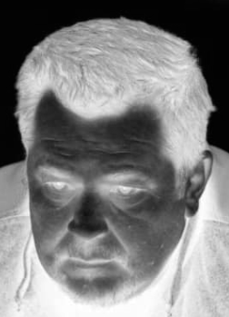

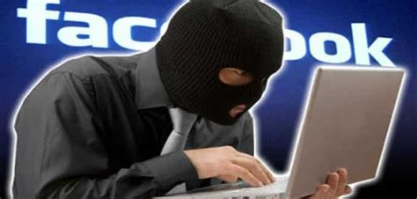
Scammer used phishing emails to steal over $100 million from Google and Facebook
Rimasauskas and his co-conspirators created fairly convincing forgery emails using fake email accounts.
Impersonated Quanta - who legitimately worked with Google and Facebook.
They sent phishing emails with fake invoices to employees at Facebook and Google who “regularly conducted multimillion-dollar transactions” with Quanta

Slide 14

Hackers siphon $47 million out of tech company's accounts
Hacker used fake emails to dupe employees of networking firm Ubiquiti into turning over usernames, passwords and account numbers.
Funds were transferred out of a Ubiquiti subsidiary in Hong Kong to other overseas accounts
Ubiquiti were able to recover $14.9 million, but the hacker was able to get away with the remaining $31.8 million

Slide 15
Phishing Tools/Resources

Slide 16
Hidden Eye - Phishing Tool - Supports over 34 pages to clone and phish, also keyloggers
OpenPhish - Phishing Intelligence
Phishing Domain Database - Testing Repository for Phishing Domains, Web Sites and Threats
Gophish - Open Source Phishing Framework
Red Team Toolkit Phishing Resource list
Awesome Red Teaming - Initial Access, including Phishing
SEToolkit (On Kali)
Metasploit (On Kali)

Slide 17
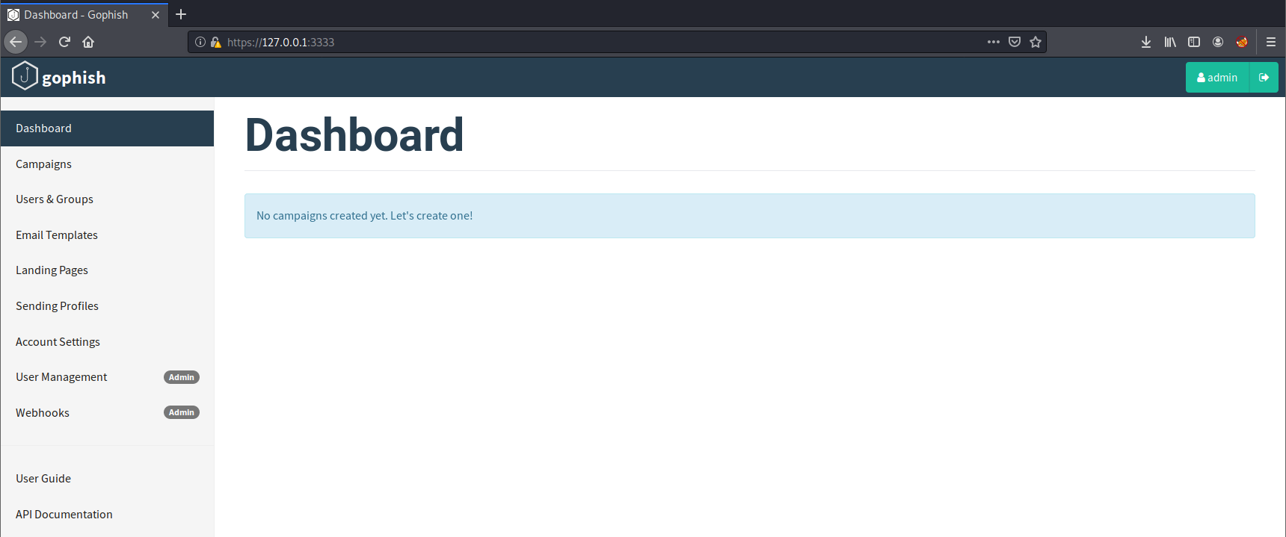
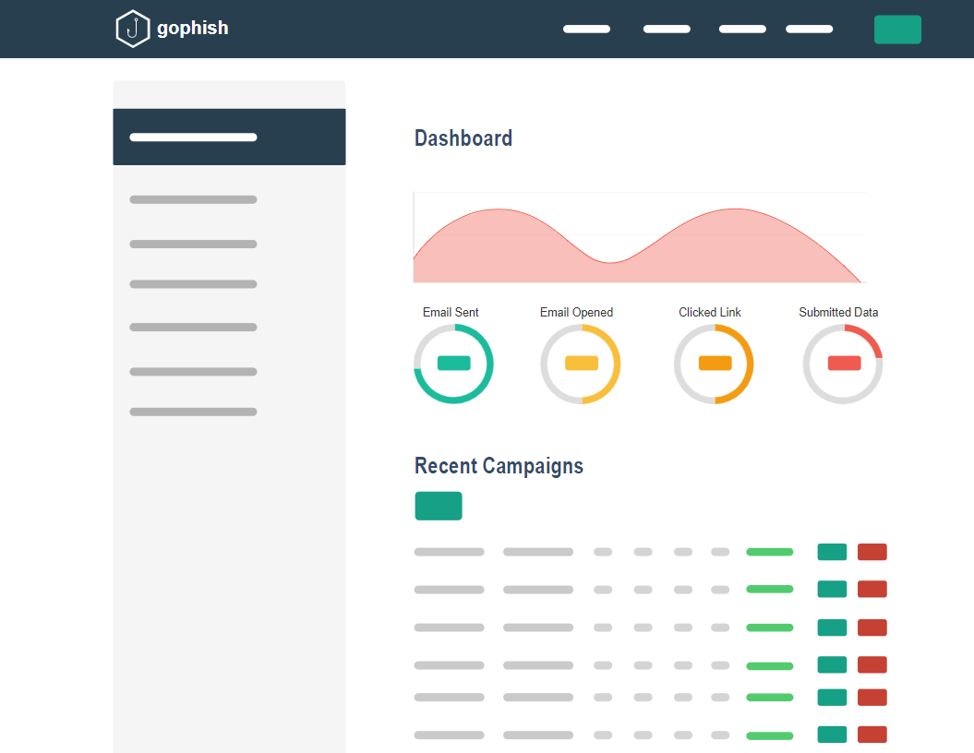
GoPhish back to your country
Gophish - Open Source Phishing Framework

Slide 18
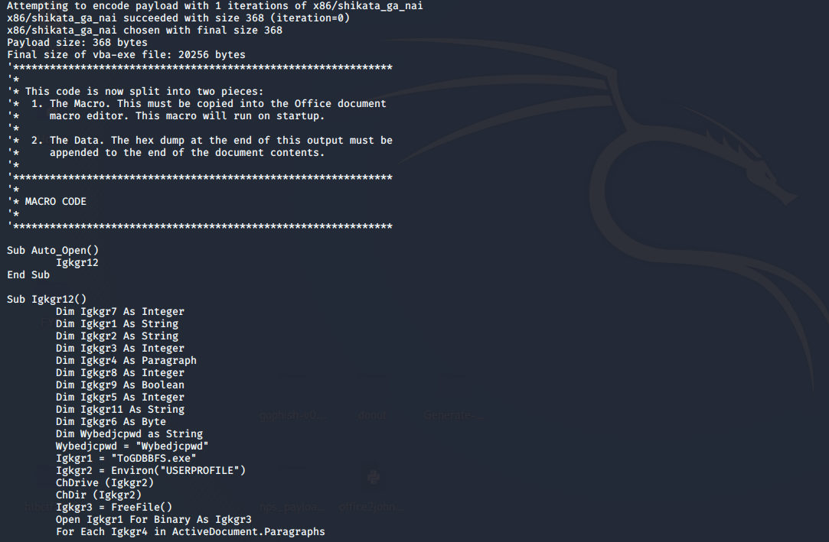
GoPhish back to your country
Metasploit MS word payload

Slide 19
Activity:
https://tryhackme.com/room/phishinghiddeneye

